Slide 1
Proposed Framework: Overview Avoidance Run UTM Implementation Rule Engine
Notes:
Let us look at the “Magic” which I mentioned Earlier.

Slide 2


Proposed framework Overview
Navigation Loop
Data Fusion
ADS-B
Situation Assessment
Events
Triggers
LiDAR
Goal Waypoint
Weather
Directives
Changes
Directives
Avoidance Run
Avoidance Grid
Map
Avoidance Trajectory
Restrictions
Reach Set
Probabilities
Notes:
Navigation Loop Provides goal waypoint from mission plan
- taken from other work
- very simple
Data fusion is providing probabilistic assessment of situation from following data sources:
- ADS-B for intruders
Lidar for static obstacles and adversaries
Weather constraints
Control authority directives
Map of obstacles
Restrictions – Geo fencing and others static restritions
These data sources are basically a static and dynamic constraints for UAS
Situation assessment – own module
- Outside Events - ex. new intruder arrival
- Internal Triggers – ex. reach of decision point
- Valid Directives – ex. Geofencing around Honeywell CZ27 building
- Probabilistic situation changes are evaluated – ex increase of danger of bird collision …
It triggers a Avoidance Run
Avoidance Run (Own work) does what I described just not …

Slide 3
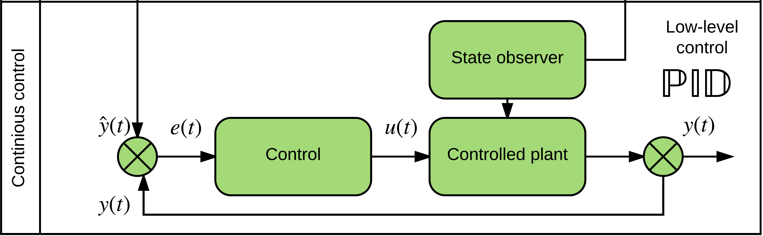
UAS model
ADS-B
Obstacle Map
LiDAR
Rule Engine
Data fusion
Mission Plan
Avoidance grid
UAS model
Movement Automaton
Reach set approximation
Notes:
Example of Vehicle control can be standard closed loop control
This has been implemented as prototype in Matlab

Slide 4
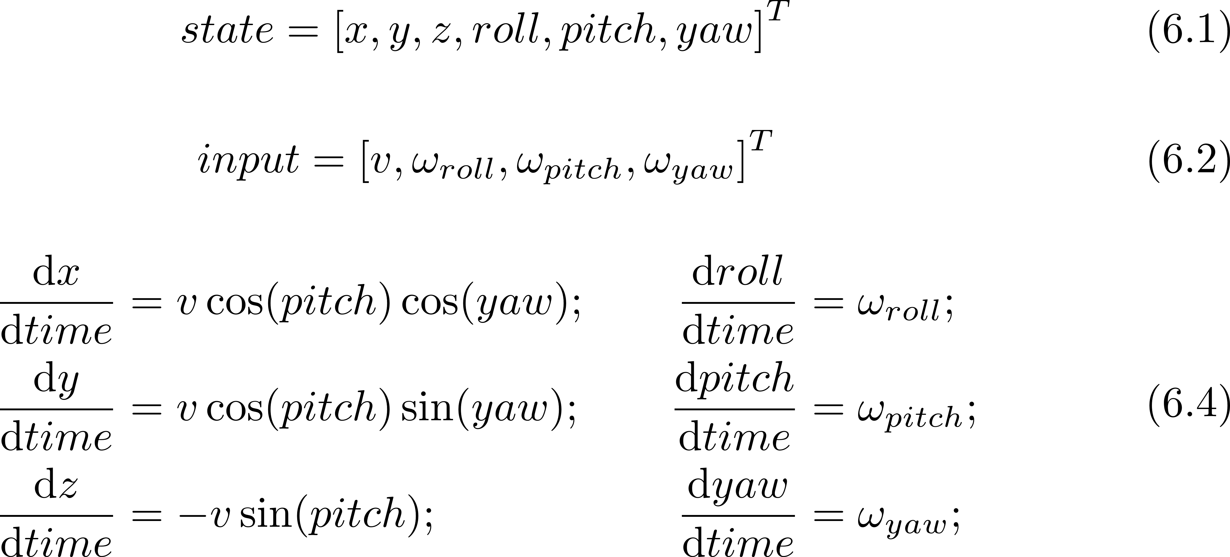
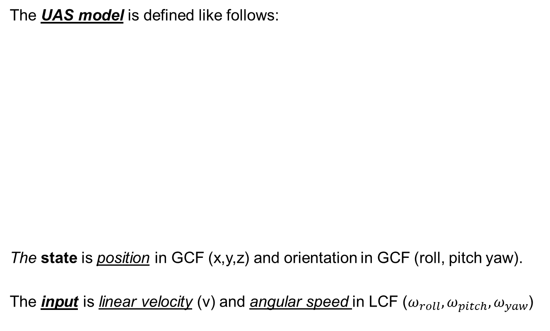
UAS model: 3D unicycle (6.2.2)
The UAS model is defined like follows:
The state is position in GCF (x,y,z) and orientation in GCF (roll, pitch yaw).
The input is linear velocity (v) and angular speed in LCF ($ω_{roll},ω_{pitch}, ω_{yaw}$)

Slide 5
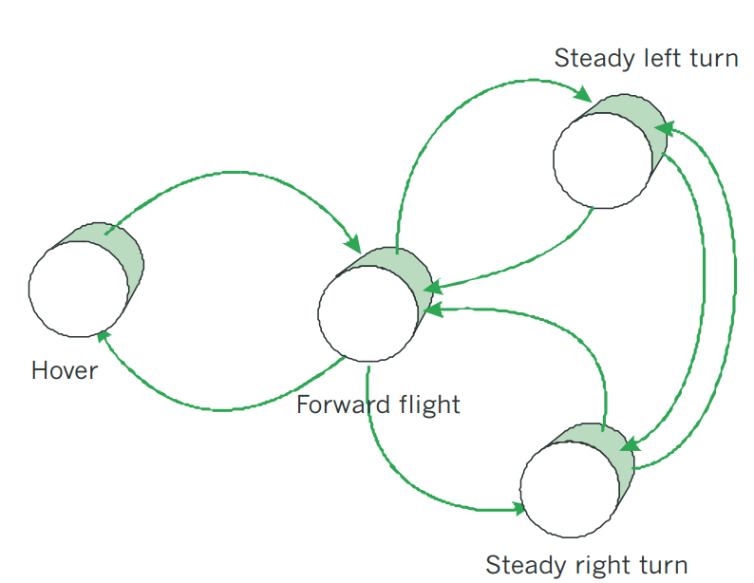
Movement Automaton
ADS-B
Obstacle Map
LiDAR
Rule Engine
Data fusion
Mission Plan
Avoidance grid
UAS model
Movement Automaton
Reach set approximation
Notes:
Movement automaton is interface acting between conventional control principles and discrete command chain
eg. Move left 2s, move strainght 2s

Slide 6
Movement Automaton: Movement set (6.2.3)
A movement set have been implemented containing movements lasting 1s:
The movement execution, with initial state represented as a red plane, looks like follow:

Slide 7
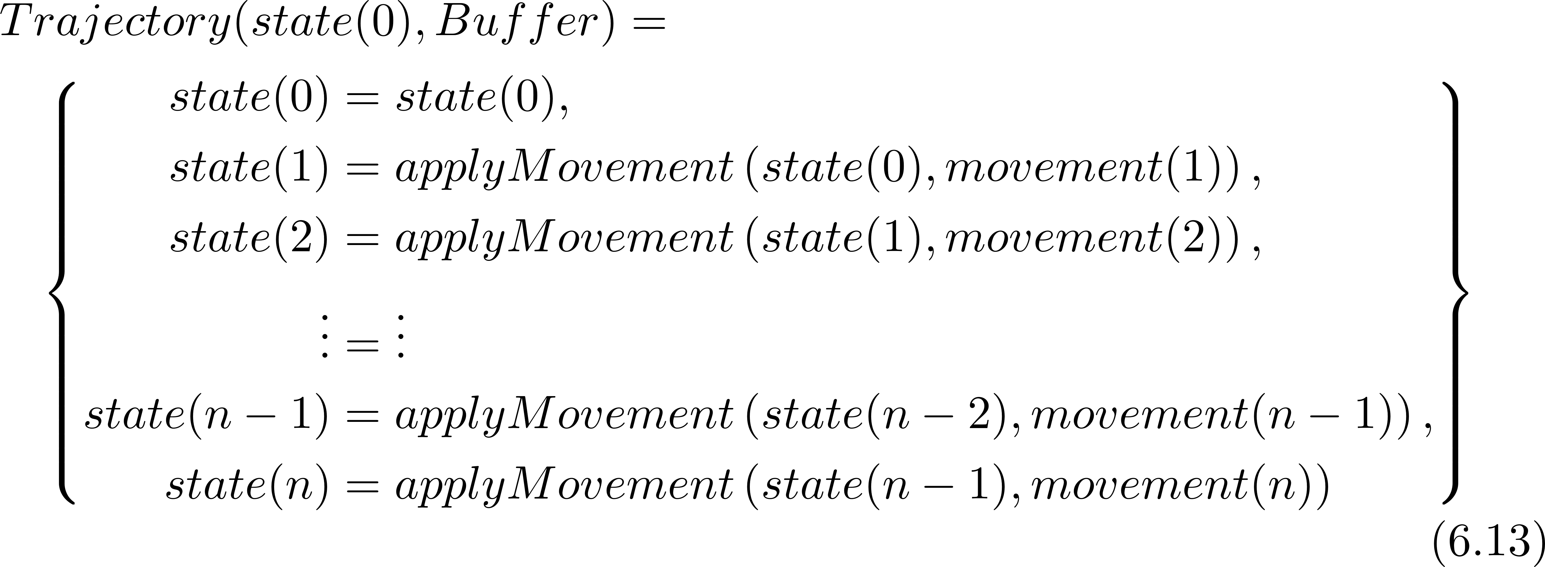
Movement Automaton: Trajectory (6.2.3)
A buffer is an ordered list of movements to be executed by UAS:
The trajectory for some initial state(0) and buffer is given as:

Slide 8
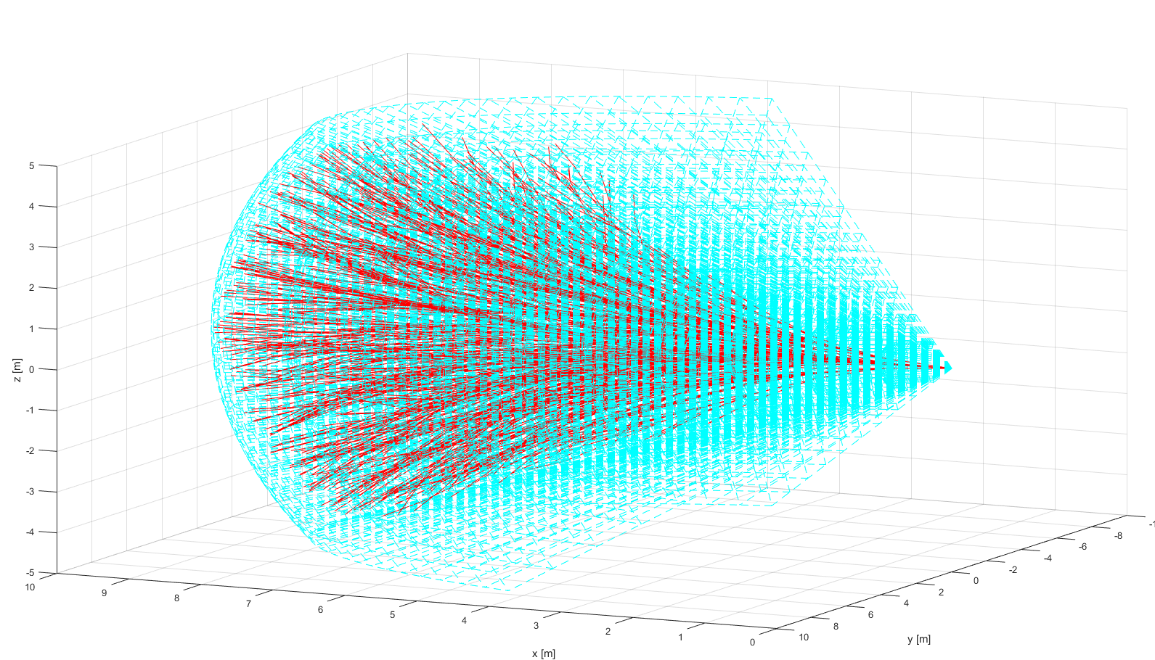
Reach set approximation
ADS-B
Obstacle Map
LiDAR
Rule Engine
Data fusion
Mission Plan
Avoidance grid
UAS model
Movement Automaton
Reach set approximation
Notes:
Example of reach set using my method (red) in Field of vision (aquamarine)
There has been implementation of prototype in Matlab (Deterministic version)

Slide 9
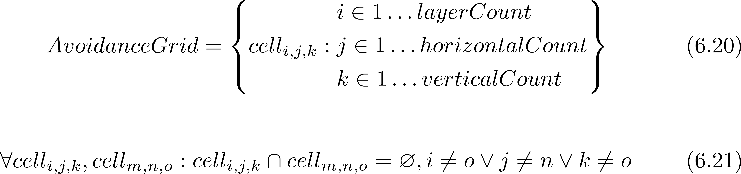
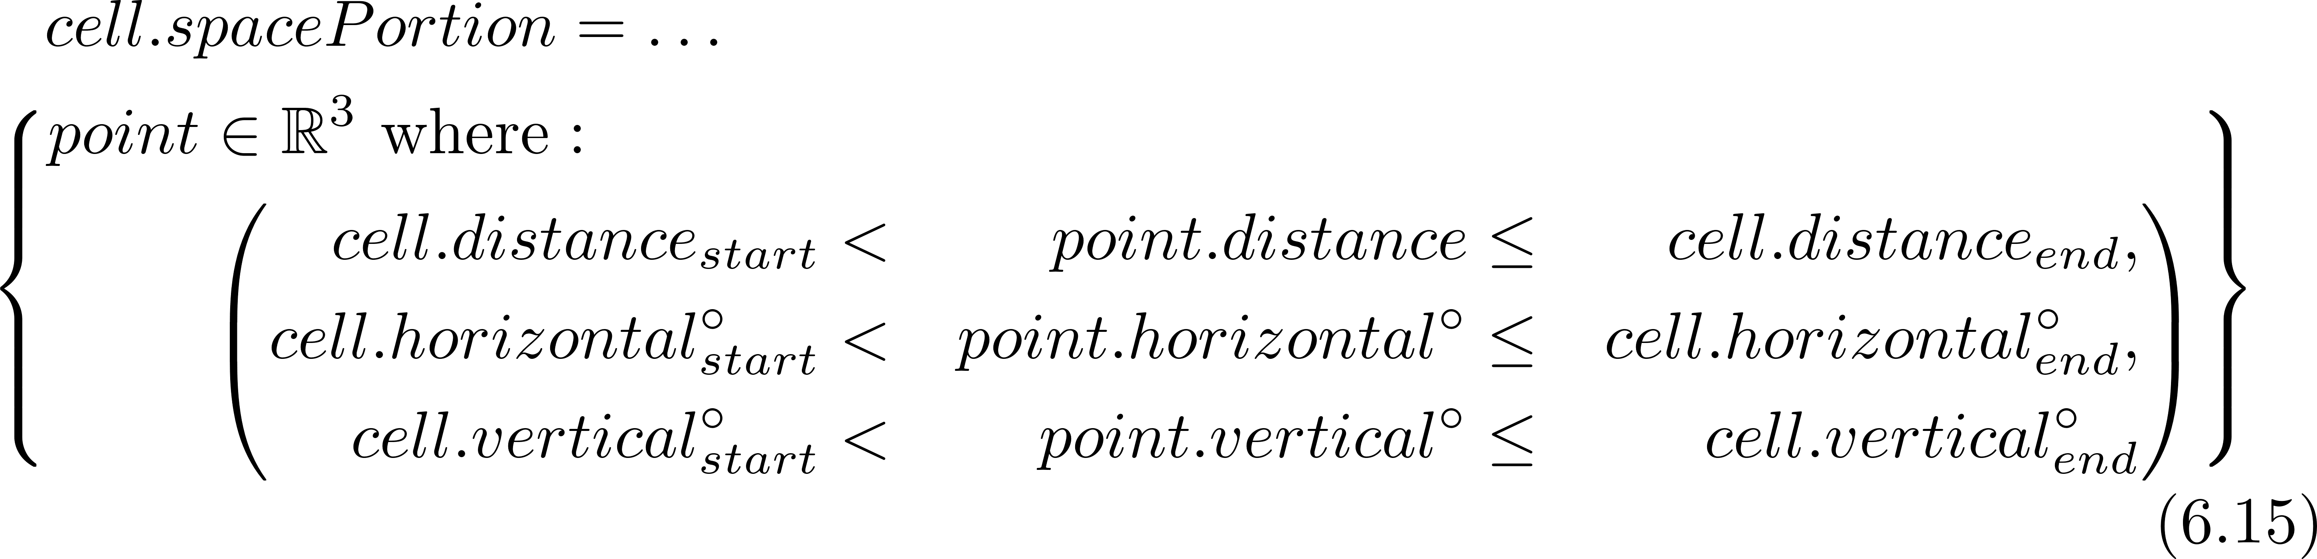
Reach set approximation Space segmentation – Avoidance Grid (6.3)
An intermediate operational space is segmented into avoidance grid:
One cell space portion is bounded by:
Refer to (def. 11,12)

Slide 10
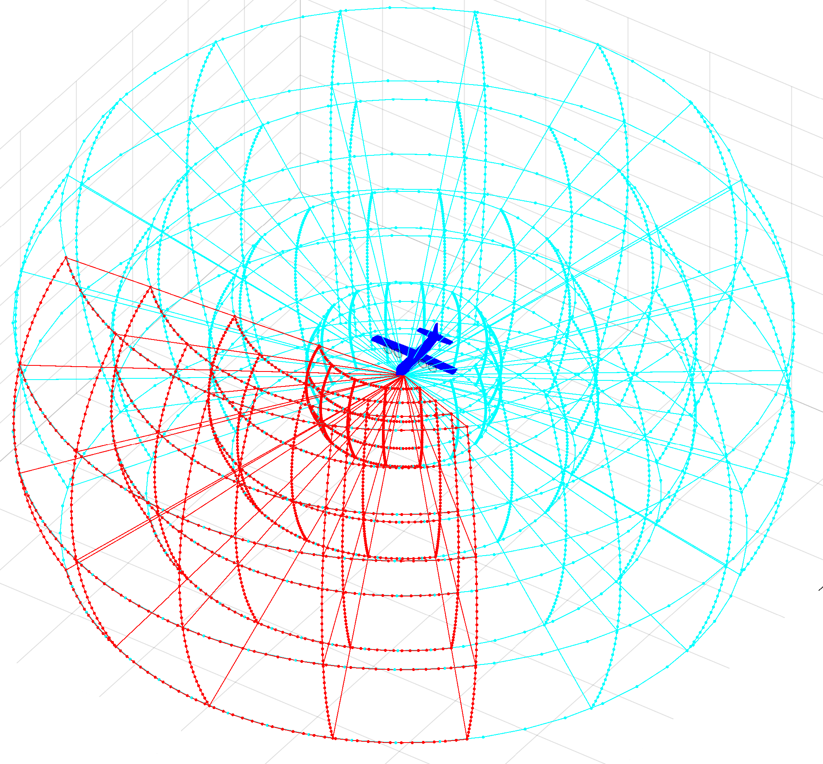
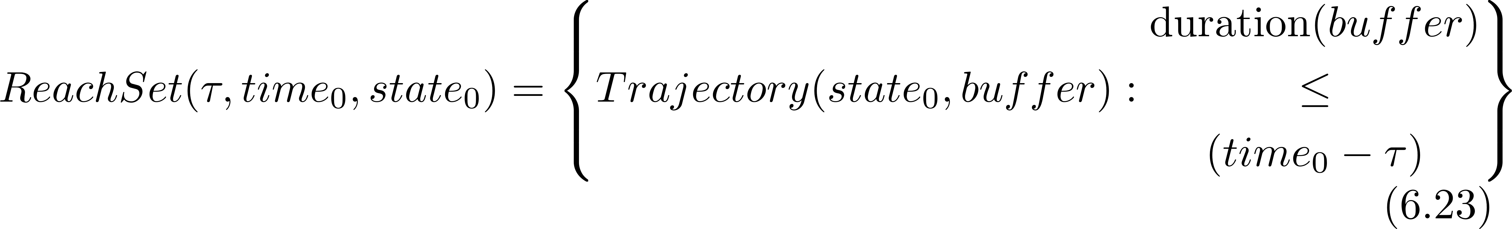
Reach set approximation The RSA definition
In segmented discrete operational space represented as avoidance grid:
The reach set approximation is a set of trajectories with common origin:

Slide 11
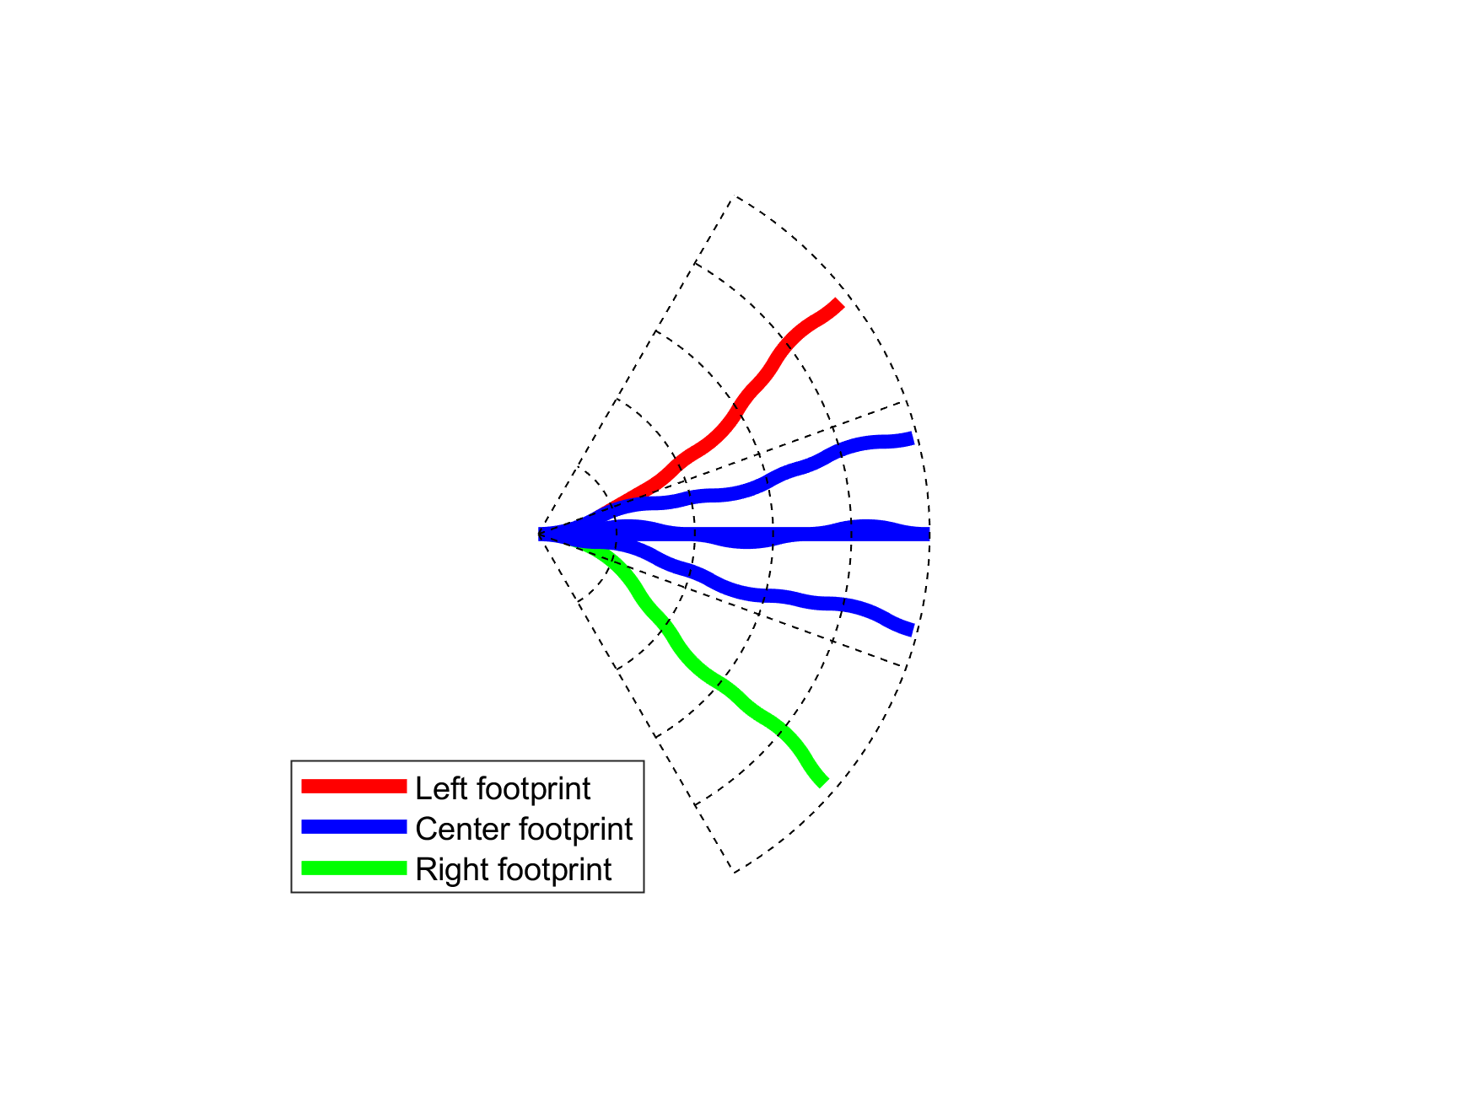
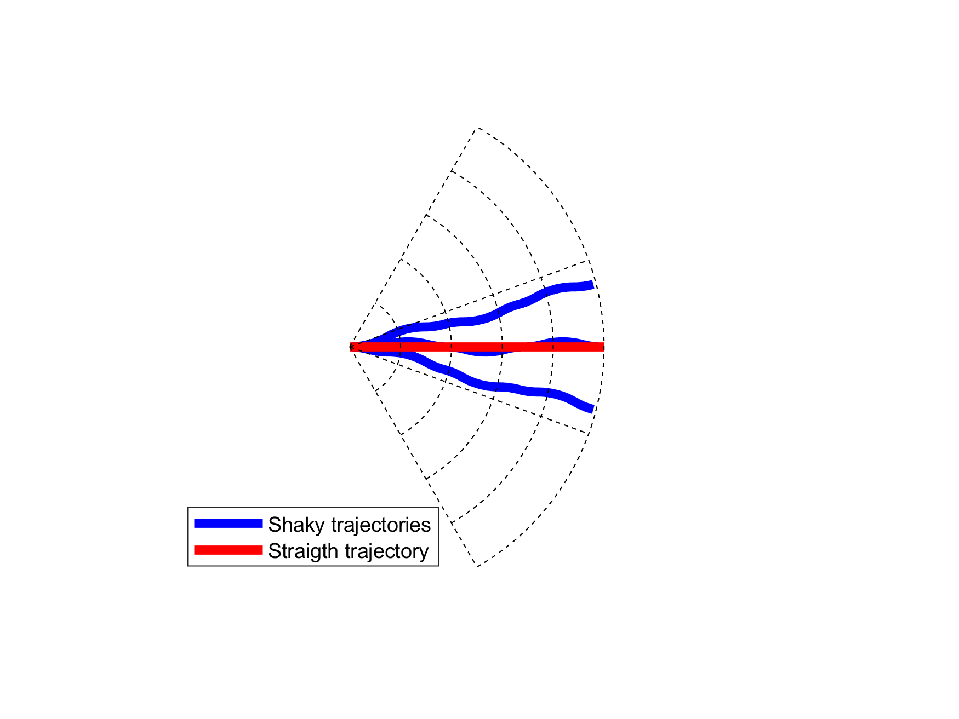
Reach set approximation: Trajectory properties (6.4.2)
Coverage – the trajectory footprint
6 trajectories 3 unique footprints
Turn ratio – count of turning movements
Try to minimize turning in reach set !
Notes:
The reach set is main point of our work, it represents where vehicle can get,
we experimented with GRAPH and TRAJECTORY SET representaitons

Slide 12
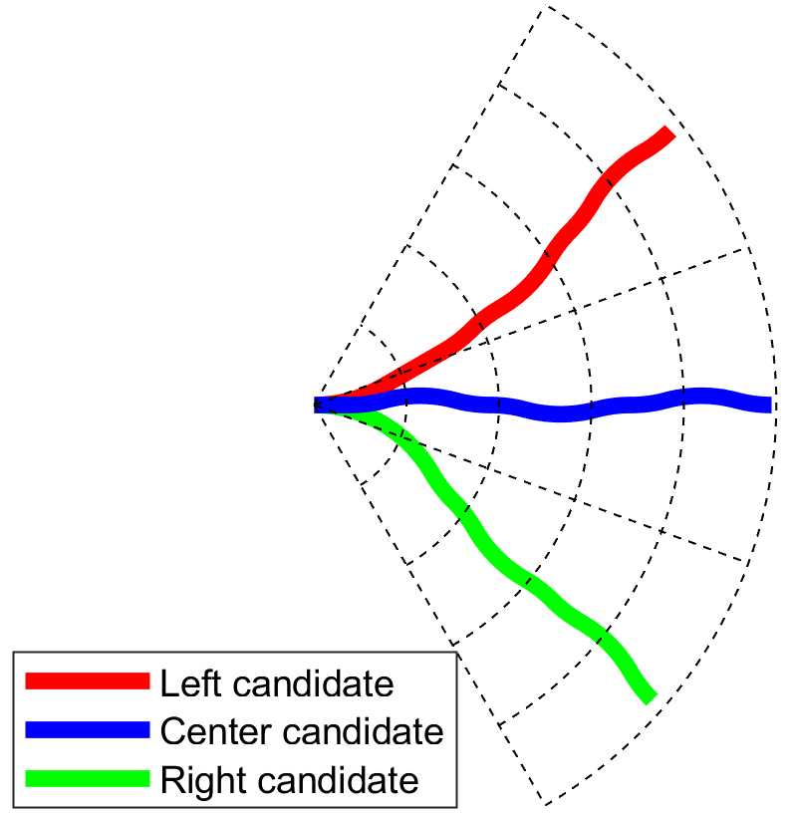
Reach set Approximation Property based approximations (6.4.3)
Get the
minimal
discrete trajectory set (RSA)
covering
all possible maneuvers
Reach set Approximation
Calculation Process (6.4.3)

Slide 13
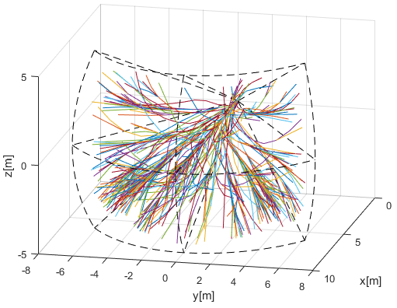
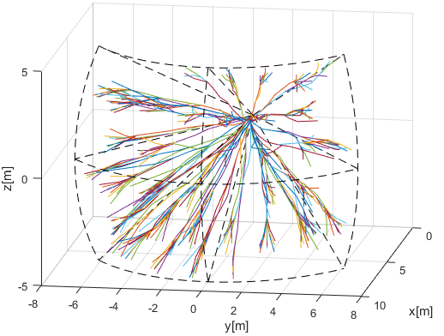
Reach set approximation: Developed Reach set Approximations 1/2
Coverage-maximizing RSA (6.4.4)
Contains trajectories with: high coverage rate
Useful for: intruder/obstacle avoidance
In: Non-controlled airspace
Turn-minimizing RSA (6.4.5)
Contains trajectories with: high smoothness
Useful for: Navigation
In: Non-controlled airspace

Slide 14
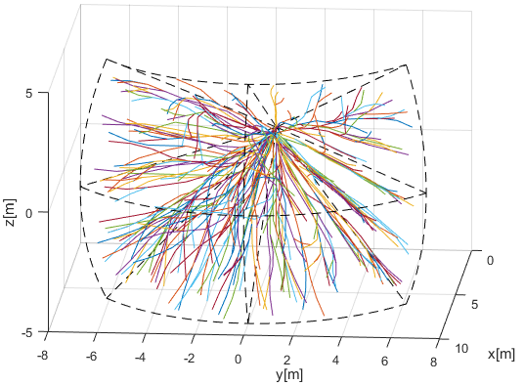
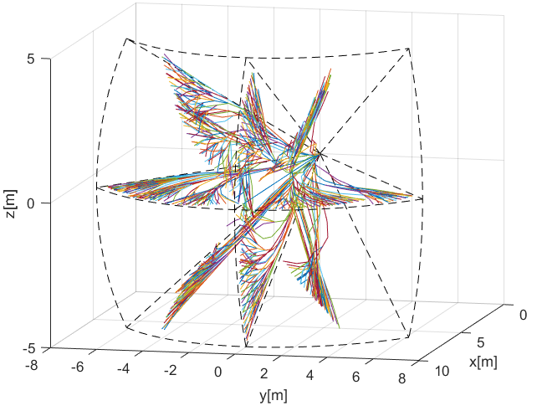
Reach set approximation: Developed Reach set Approximations 2/2
Combined RSA (6.4.7)
Contains trajectories with: TM + CM RSA combination
Useful for: avoidance/navigation
In: Controlled airspace in case of Emergency
ACAS-like RSA (6.4.6)
Contains trajectories with: ACAS behavior
Useful for: Navigation/UTM Resolutions
In: Controlled airspace

Slide 15
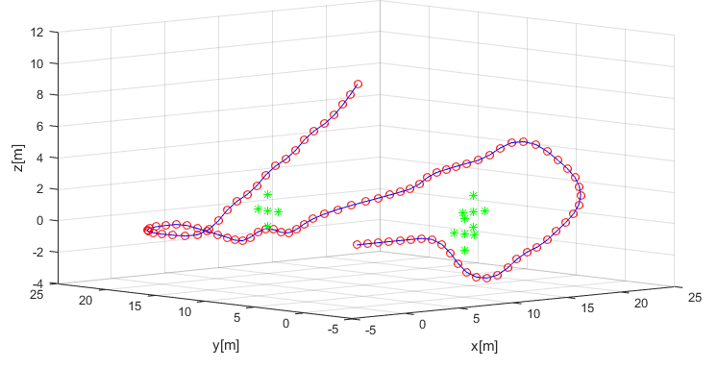
Mission plan
ADS-B
Obstacle Map
LiDAR
Rule Engine
Data fusion
Mission Plan
Avoidance grid
UAS model
Movement Automaton
Reach set approximation
Notes:
Example of simple mission with 4 waypoints, implemented as Matlab simulation

Slide 16
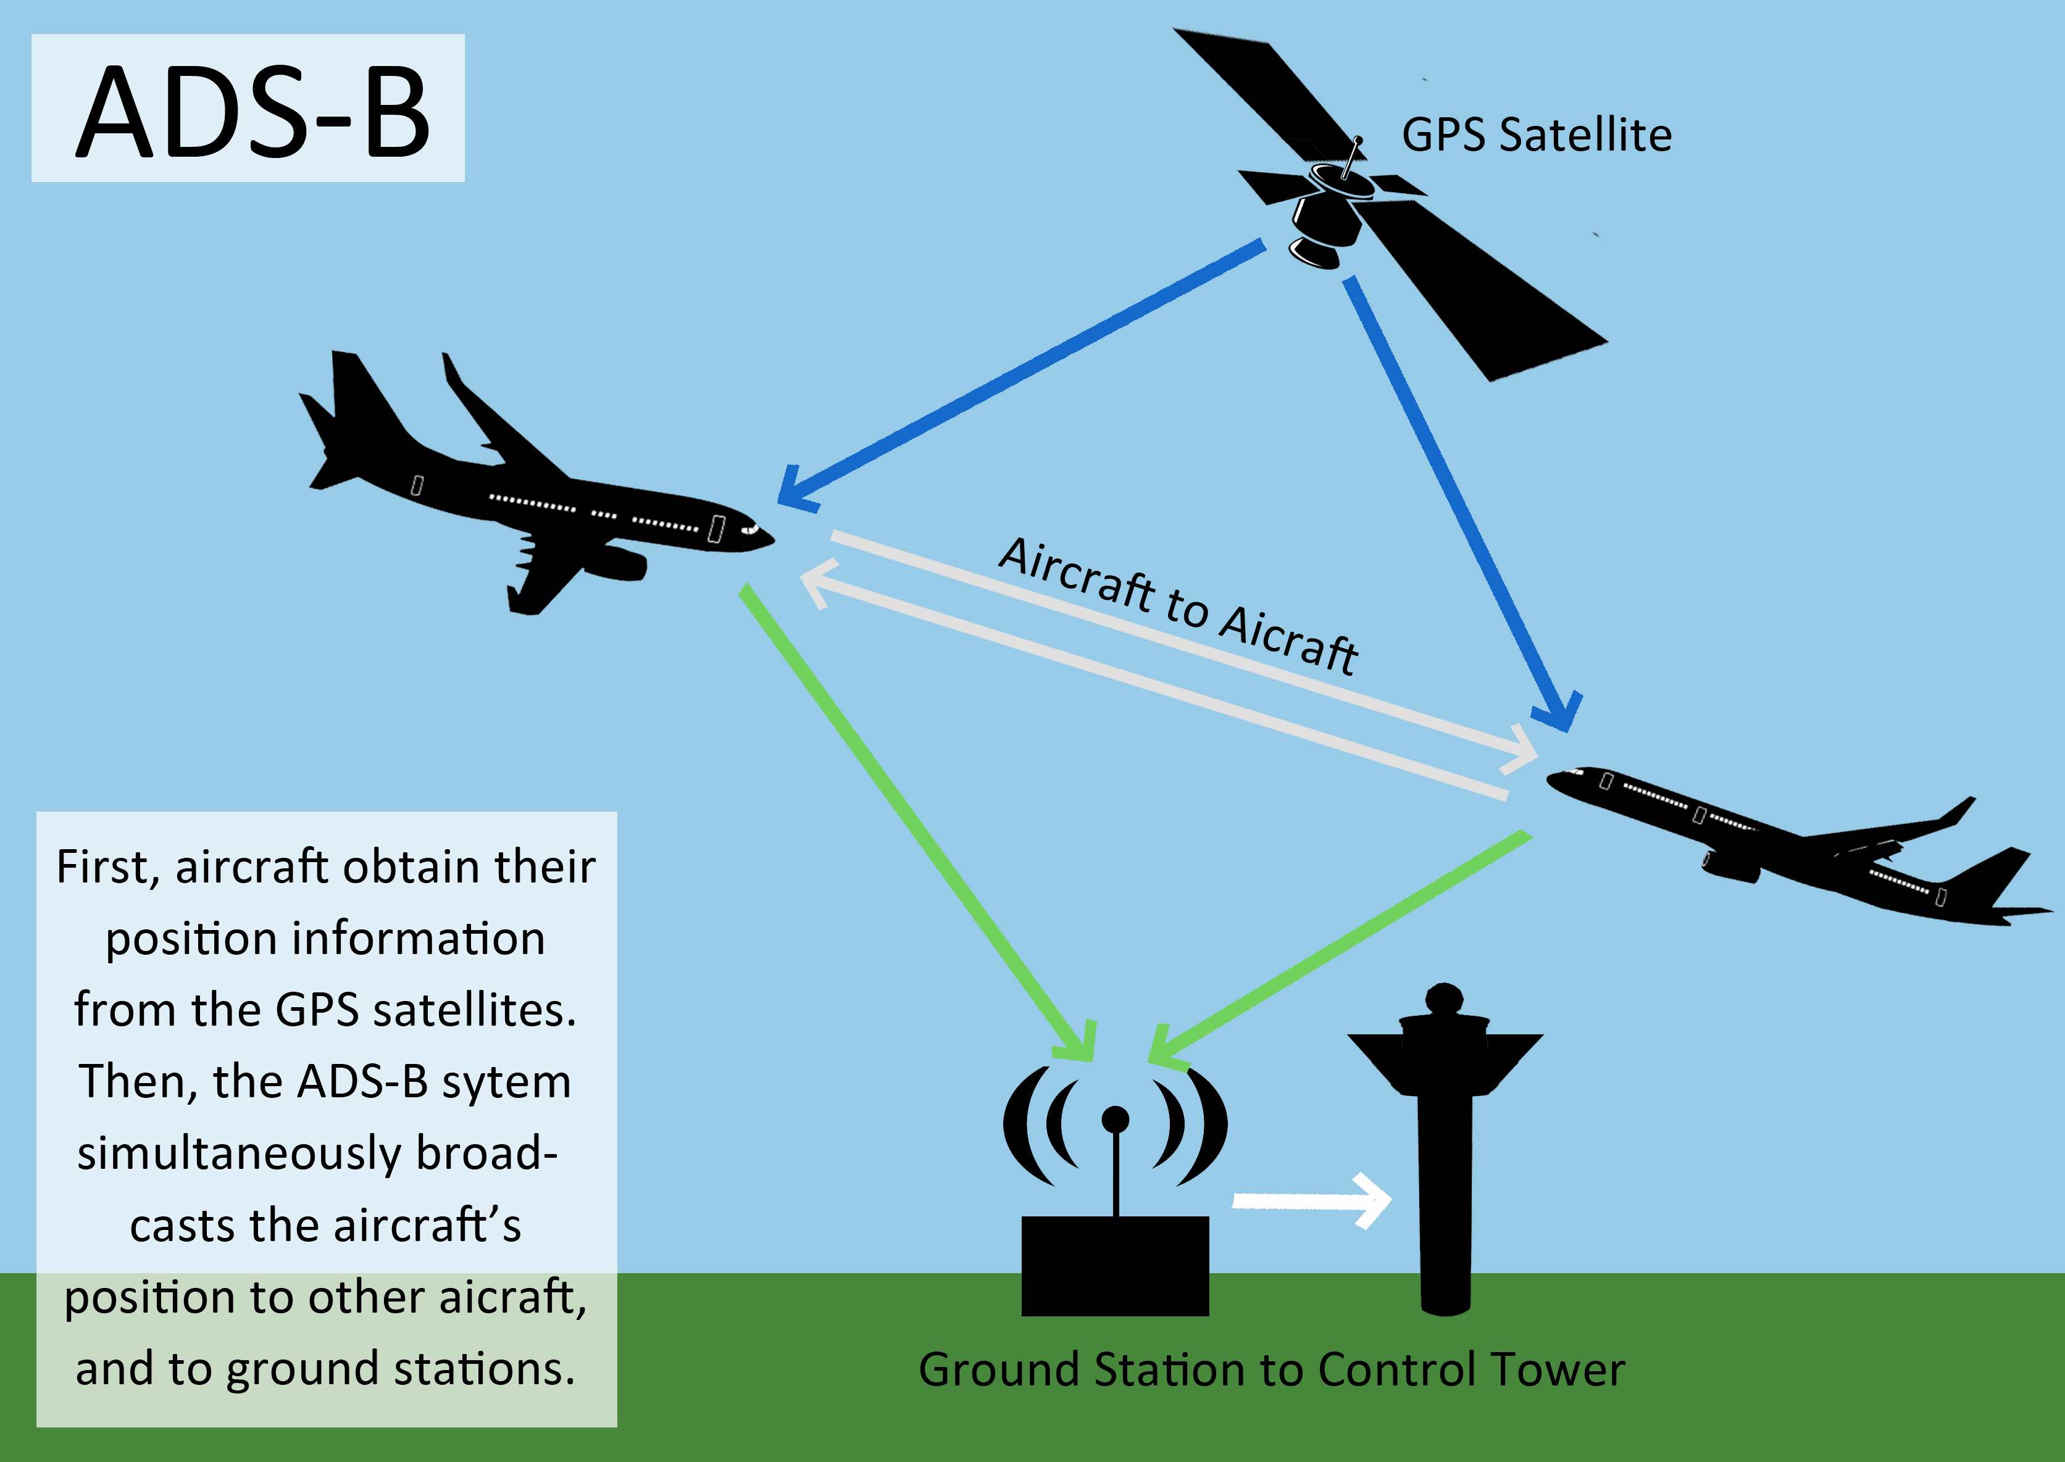
ADS-B
ADS-B
Obstacle Map
LiDAR
ADS-B
Rule Engine
Data fusion
Mission Plan
Avoidance grid
UAS model
Movement Automaton
Reach set approximation
Notes:
Here is an example of ADS-B

Slide 17
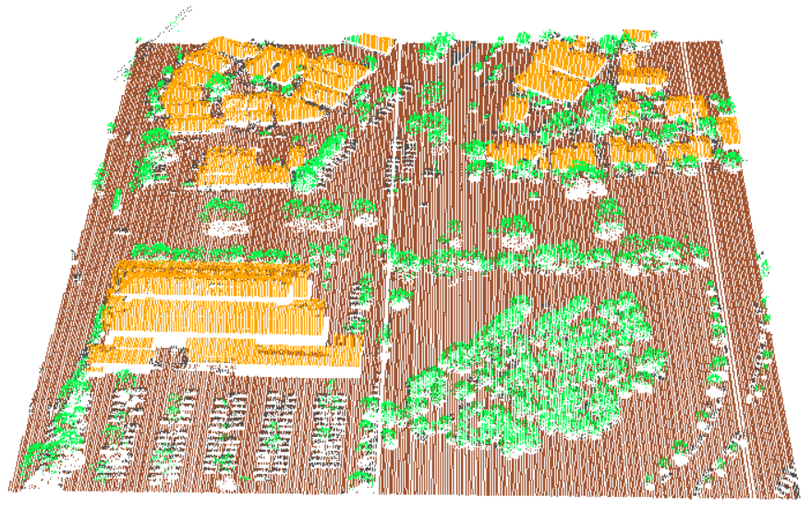
LiDAR
ADS-B
Obstacle Map
LiDAR
Rule Engine
Data fusion
Mission Plan
Avoidance grid
UAS model
Movement Automaton
Reach set approximation
Notes:
In the picture you can see example of Flash Lidar scanned area over trajectory

Slide 18
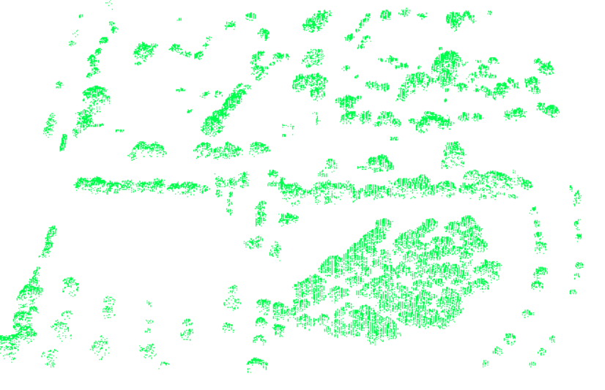
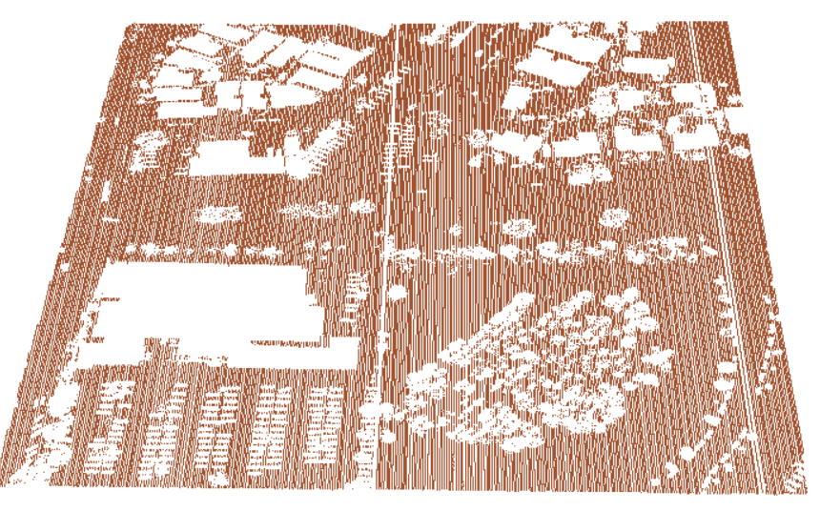
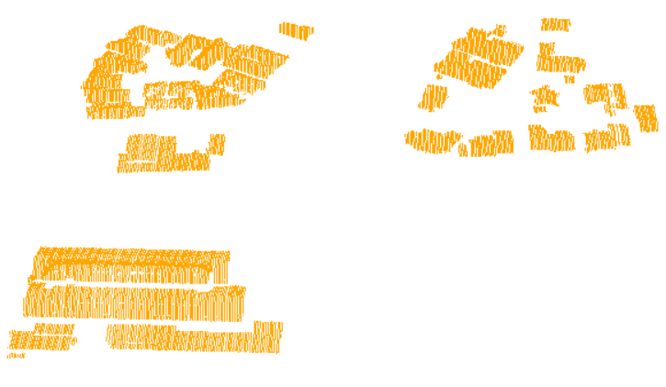
Offline Maps – created from classified data
All data
Vegetation
Terrain
Buildings
[*] Maria Cerna. Usage of maps obtained by lidar in uav navigation. Master thesis, Institute of Automotive Mechatronics,
Faculty of Electrical Engineering and Information Technology, Slovak University of Technology, Ilkovicova 3, Bratislava. Slovak Republic, jun 2018.

Slide 19
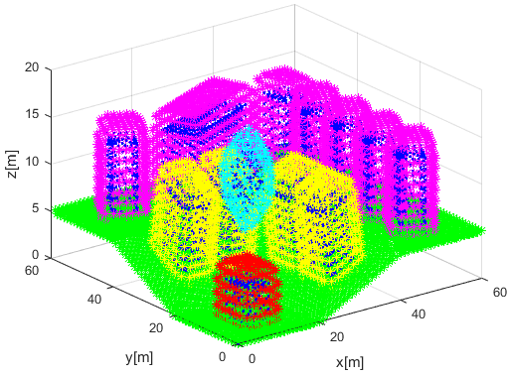
Obstacle Map
Obstacle Map
ADS-B
Obstacle Map
LiDAR
Rule Engine
Data fusion
Mission Plan
Avoidance grid
UAS model
Movement Automaton
Reach set approximation
Notes:
Here is example of cuboid coatings (dark blue) with virtual convex coating (magenta, cyan, yellow, red)

Slide 20
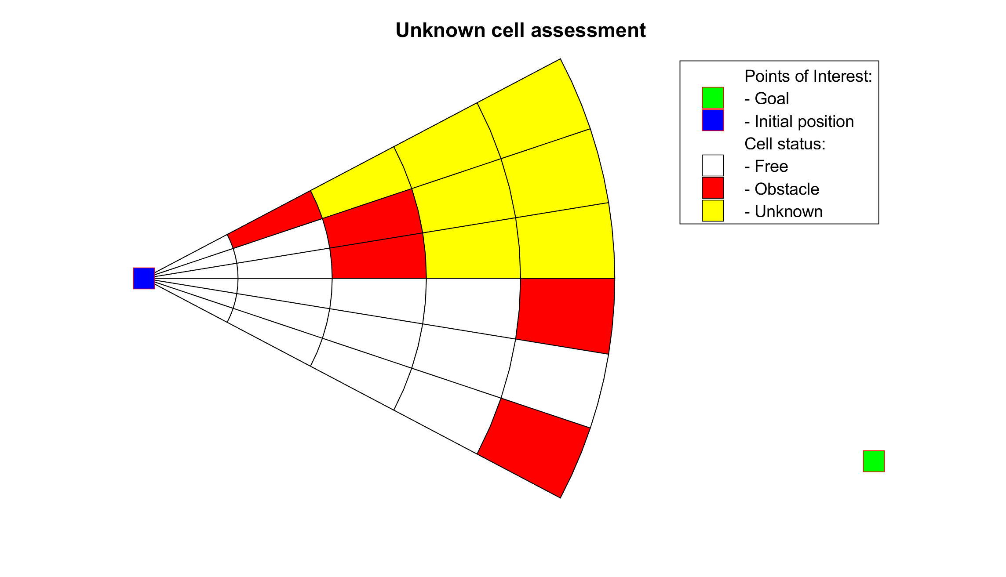
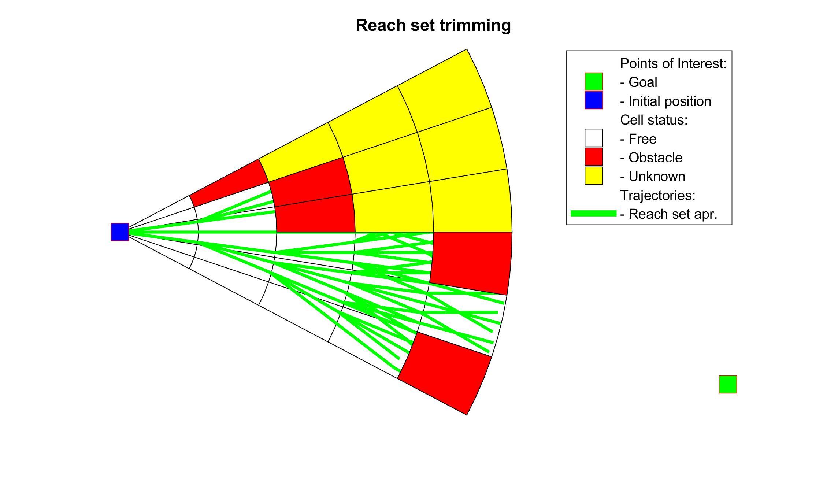
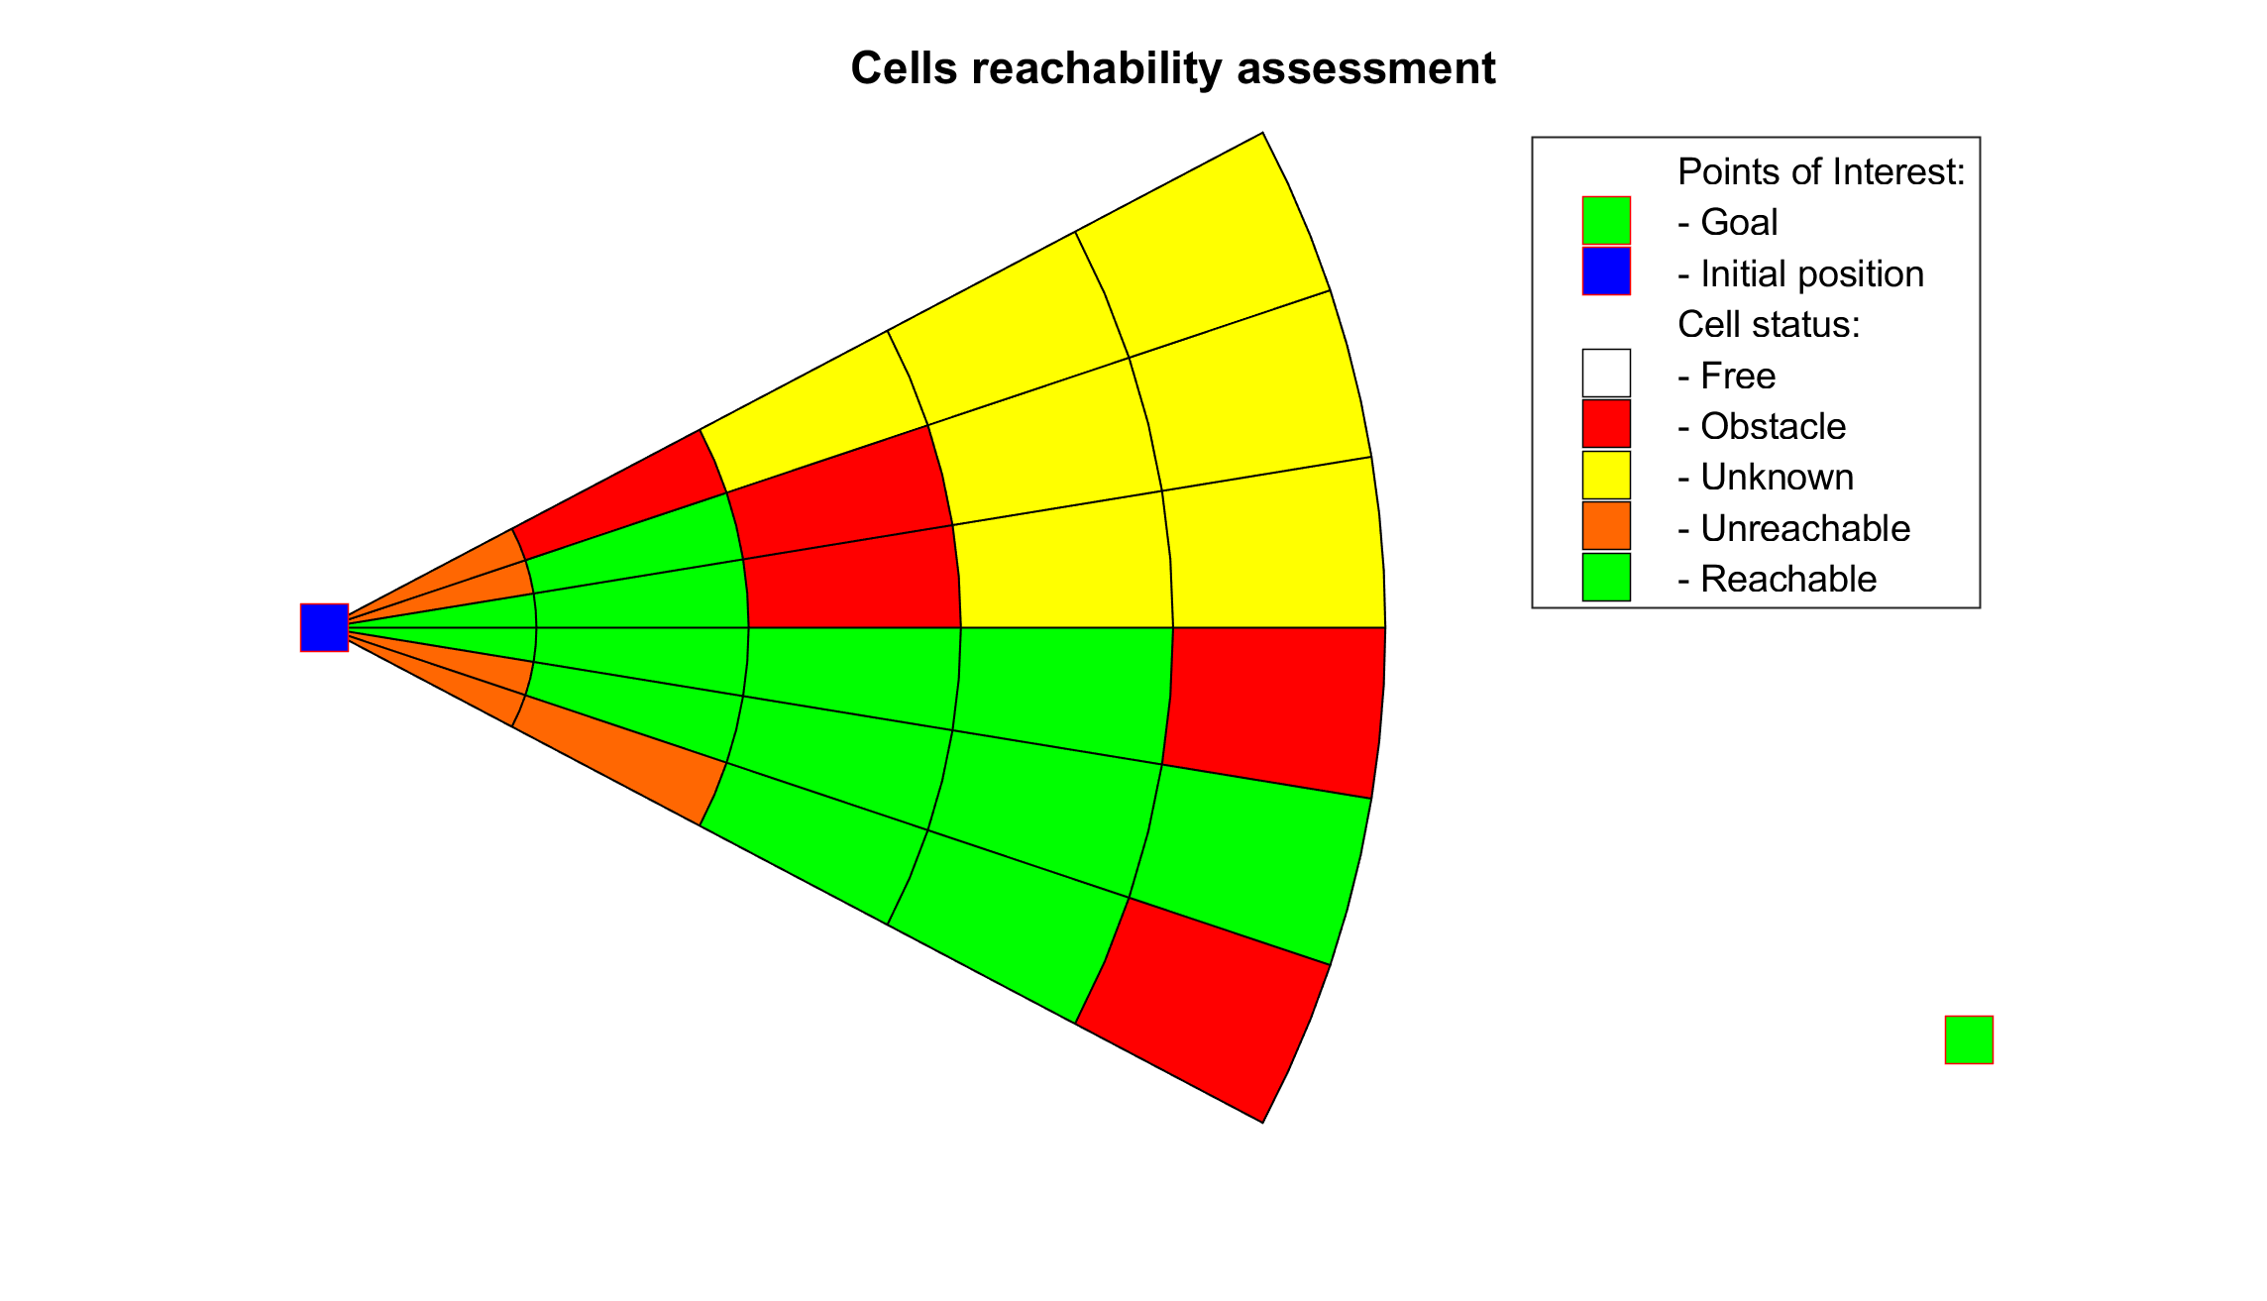
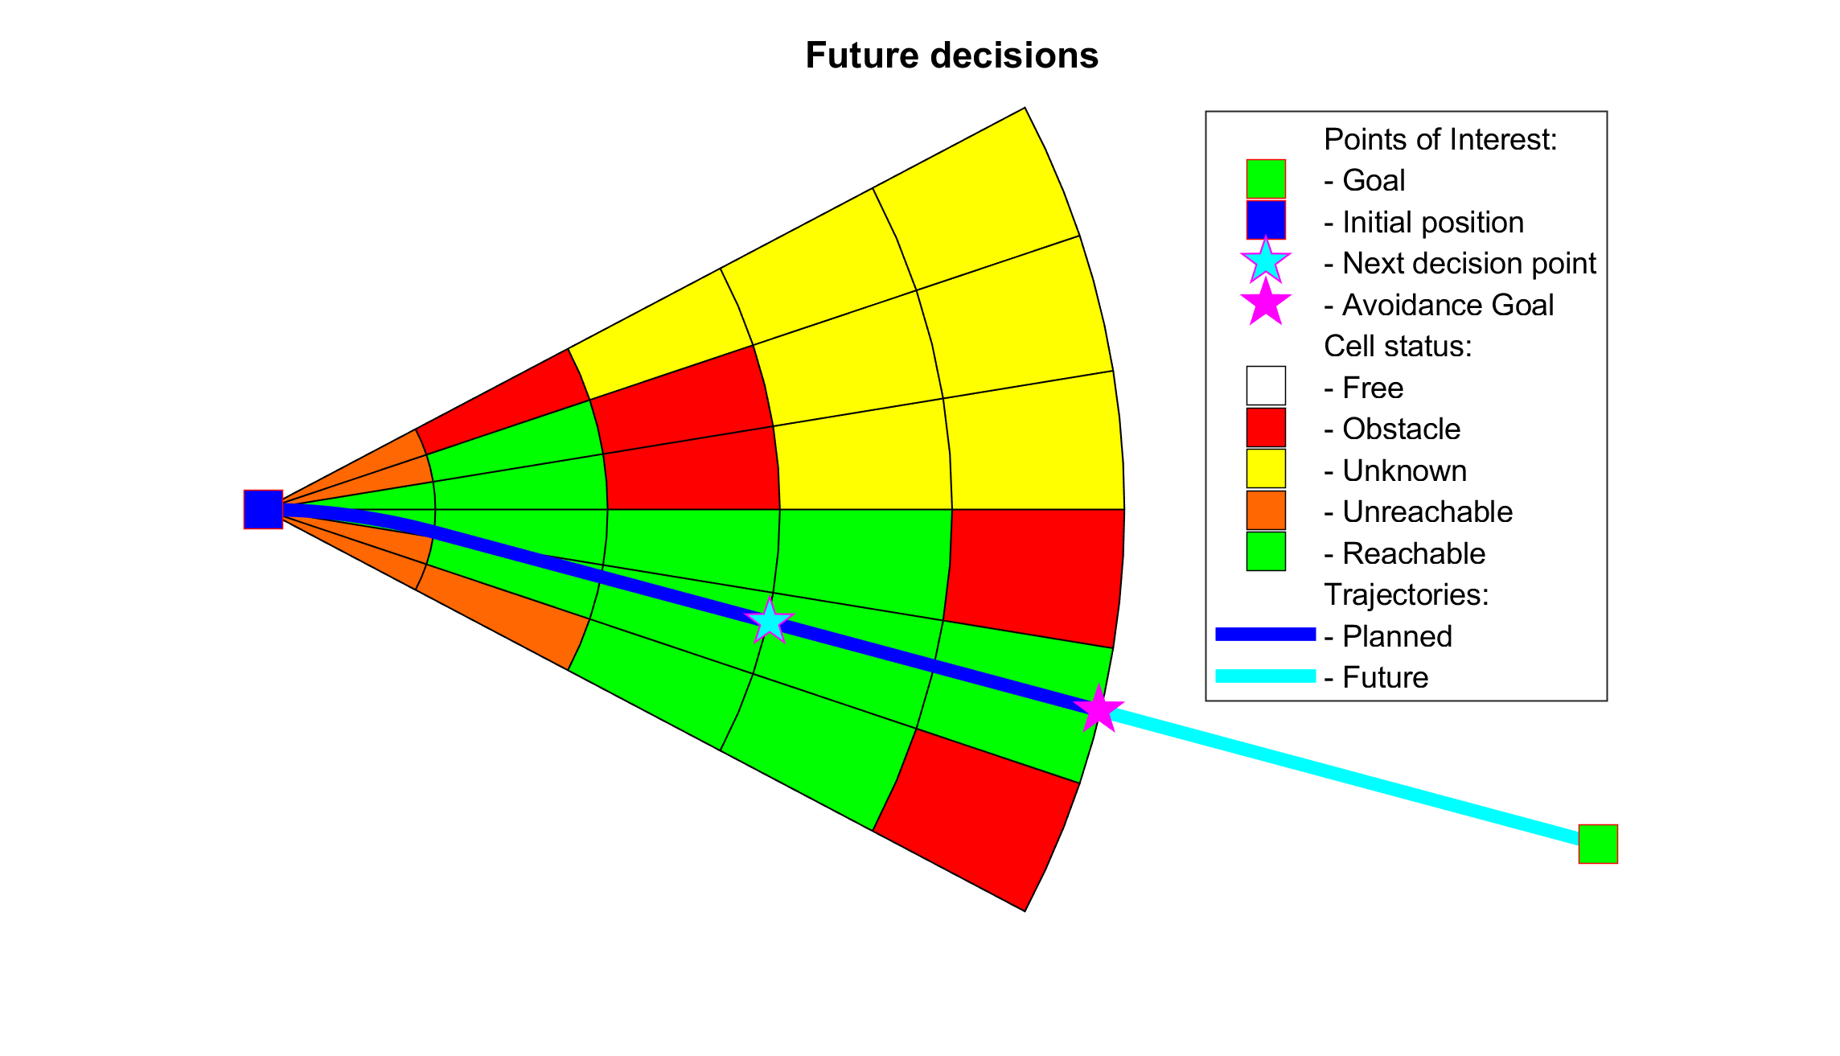
Avoidance Grid
ADS-B
Obstacle Map
LiDAR
Rule Engine
Mission Plan
Data fusion
Avoidance grid
UAS model
Movement Automaton
Reach set approximation
Notes:
The interesting process of Avoidance Run consist from following steps

Slide 21
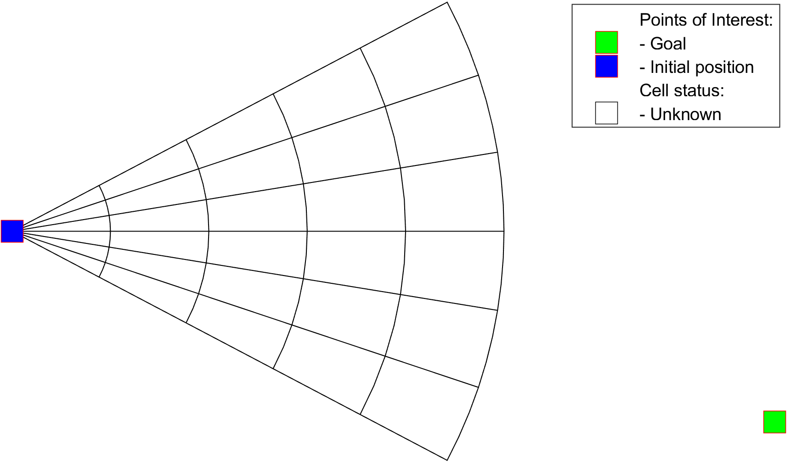
Avoidance run (6.5.1) Step 1/7 Initialization

Slide 22
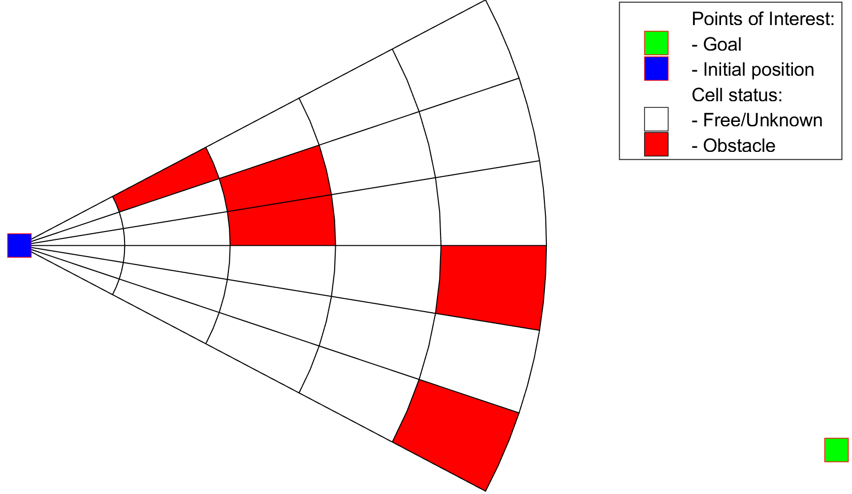
Avoidance run (6.5.1) Step 2/7 Threat (obstacle) assessment

Slide 23
Avoidance run (6.5.1) Step 3/7 Unknown state of the cells

Slide 24
Avoidance run (6.5.1) Step 4/7 Reach set approx. projection

Slide 25
Avoidance run (6.5.1) Step 6/7 Reachable/Unreachable

Slide 26
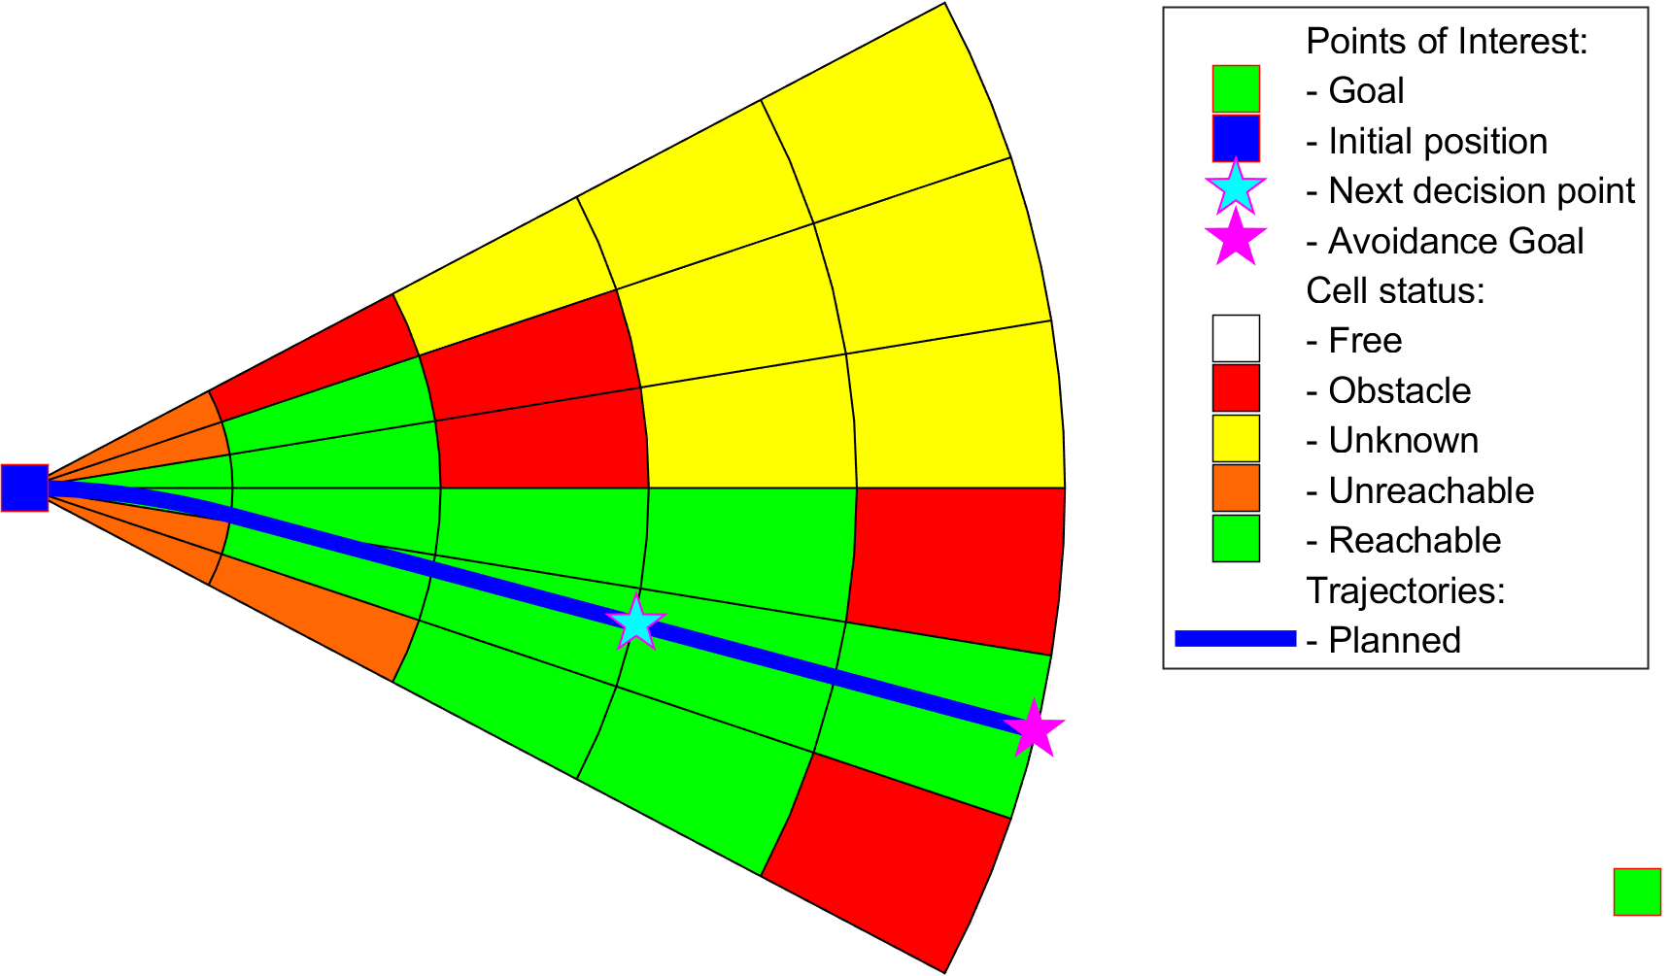
Avoidance run (6.5.1) Step 7/7 Trajectory selection

Slide 27
Mission control run (6.5.2) Multiple avoidance run joined together

Slide 28
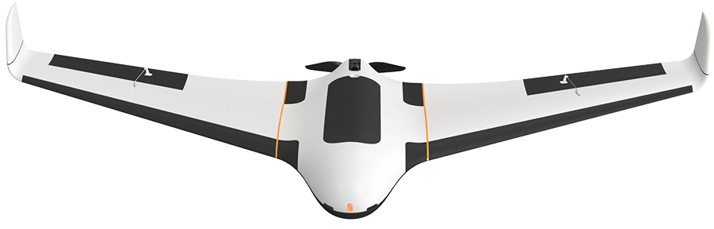
UAS Traffic Management Concept
Each vehicle is calculating Collision Cases to nearby vehicles,
UTM is also calculating Collision Cases to cluster vehicles,
UTM issues Resolution advisories or separation rules to prevent collision
Resolution
UAS 1
Mission Control
Navigation Grid
Collision Case
Position notification
UAS Traffic Management
UAS 2
Position notification
Mission Control
Navigation Grid
Resolution
Notes:
Similar to Air Traffic Management there is UAS Trafic Management
Let say an authority which manages own portion of airspace.
Each UAS have Mission control module which is managing the Navigation
Mission Control Module is periodically sending Position notification To UAS Traffic Management
UAS traffic management is monitoring traffic and detecting collision situations and creating Collision Cases,
Collision Case is focused part of UTM control to prevent collision.
Each UAS will receive Resolution advisory to avoid dangerous areas or to change courses,
UTM then monitors the behavior of dangerous UAS and changes traffic accordingly to it
(Show stuff meanwhile talking)

Slide 29
Rule engine
Context
Gather
Context
Rule Engine
Invoke
Engine
Decision point
(Join point)
Mission Control
Rule
Navigation Grid
My mission
Velocity Recalculation
Invoke Rule Instance
Parser
Check condition:
Intruder Velocity
Application
Parse context:
Intruder Position
Take action:
Slow down
Condition
Notes:
On the mission control level we have implemented Rule Engine
Rule engine is module which oversees process at critical Decision points,
When condition to alter a process are met Rule engine invokes a Rule with a Context.
In the picture there is a example of Speed check,
In Navigation module at velocity recalculation step the rule is invoked,
We observed an intruder which is very slow and we are going to take it down,
We check intruder velocity in rule Condition part
Then we take action to Slow down
(Show stuff meanwhile talking)

